Slide 1
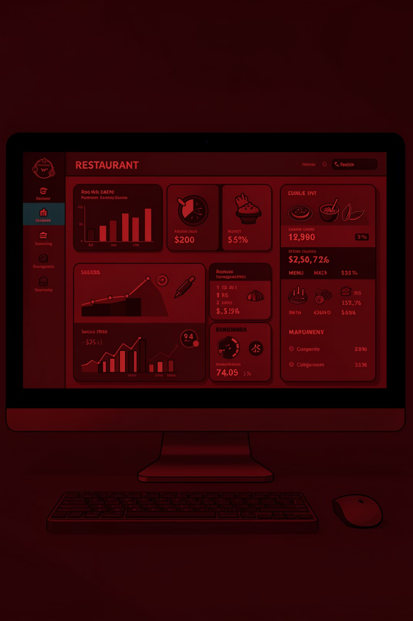
Zomato Data Manipulation and Reporting using Power BI
Consolidated Interactive Business Intelligence Report
A comprehensive Power BI solution for global restaurant data analysis and business intelligence

Slide 2

Project Context
The Challenge
The Need
Zomato operates globally with restaurant data scattered across multiple Excel files. This fragmented structure creates inefficiencies in data management and analysis.
Organizations require structured, interactive reporting tools to identify performance patterns, detect irregularities, and extract actionable business insights from complex datasets.

Slide 3




Problem Statement
Global Data Complexity
Data Fragmentation
Restaurant data spans multiple continents with inconsistent naming conventions and scattered information across files
Multiple Excel files lack consolidation, making comprehensive analysis time-consuming and error-prone
Quality Issues
Reporting Gap
Data inconsistencies include incorrect city names and scattered cuisine details requiring standardization
Need for structured, interactive reporting to identify performance patterns and business insights efficiently

Slide 4
Project Objectives
01
02
03
Total Restaurant Count
Performance Analysis
Filtering System
Derive comprehensive counts globally with drill-down capability by continent, country, and city
Identify restaurants with highest average ratings and lowest average costs
Enable filtering by location, services, and rating color for targeted analysis
04
05
Cuisine Insights
Interactive Report
Discover restaurants serving the most diverse cuisine options
Build multi-page interactive report accessible via web and mobile devices

Slide 5


Data Preparation & Transformation
Multi-File Import
Consolidated data from multiple Excel files into unified dataset
Error Correction
Fixed city name errors including São Paulo, Istanbul, and Cedar Rapids
Column Optimization
Removed unused columns and created Restaurant Name and Address fields
Structural Enhancement
Created separate Cuisine table with unique non-blank Country Code values

Slide 6

DAX Implementation
1
2
3
Rating Color Column
Key Measures
Geographic Mapping
Classified ratings based on thresholds: Above 4.5 (Dark Green), 4.0-4.4 (Green), below 4.0 (Yellow/Red)
Restaurant Count, Average Cost, Average Rating, and Cuisine Count for quantitative analysis
Added Continent column to Country Code table using continent-country mapping for regional analysis

Slide 7
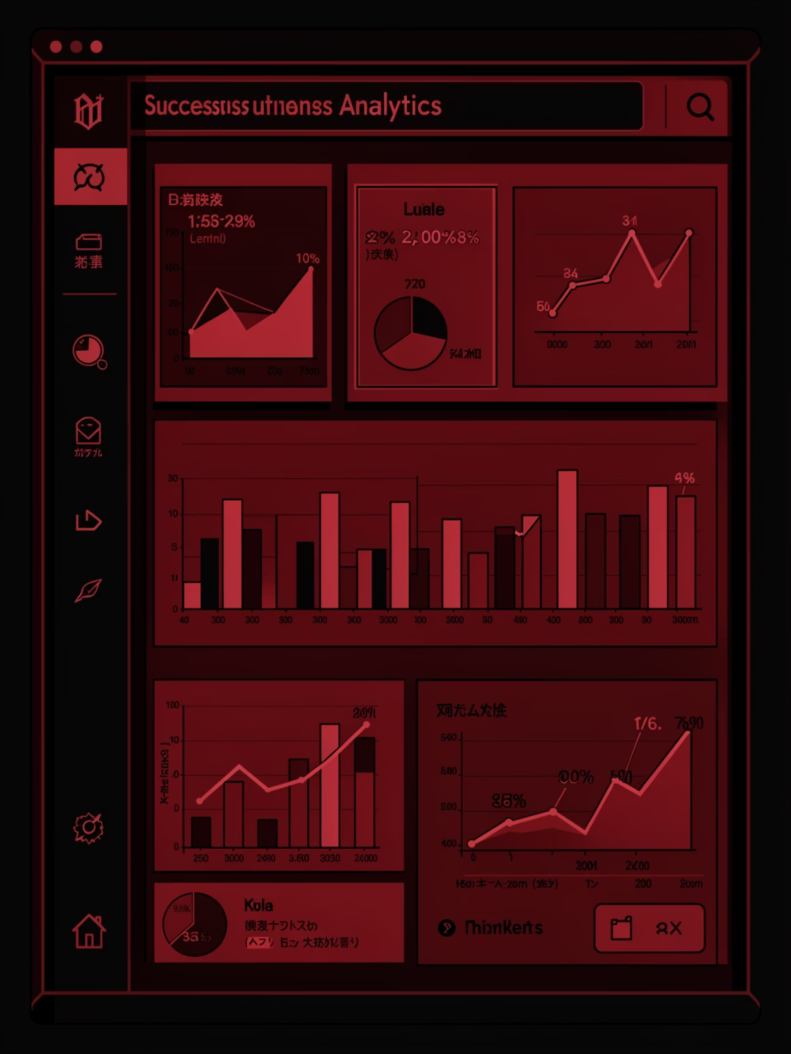
Project Outcome
Aim
Construct a consolidated and interactive Power BI report enabling Zomato to quickly assess required business data and make informed decisions.
Key Achievements
Centralized global restaurant data from scattered sources
Interactive filtering and drill-down analysis capabilities
Easy identification of high-performing and low-cost restaurants
Enhanced business performance evaluation and decision-making
Cross-platform accessibility via web and mobile devices

